Slide 1
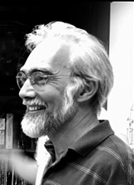
Presentation 101 for Graduate Students
J. Paul Robinson
SVM Professor of Cytomics
Department of Basic Medical Sciences
& Weldon School of Biomedical Engineering
Purdue University
A set of suggestions and examples for creating good quality presentations.
What to do and what not to do in your seminar!!
This presentation is available for download from
http://www.cyto.purdue.edu/education
Presented to grad students each year since 2000
This version 2003

Slide 2
Notes for those reading this presentation from this online version
It is not ideal to review a set of slides without having heard the presentation. However, I have put them on line to assist new students when they have to give seminars or conference talks. My suggestions are mainly for beginners, but some things carry all the way to experienced speakers. My goal was to increase the confidence of students by giving them a solid basis to use when preparing their slides. To understand each slide, I suggest you download the PPT file and play it on your computer. I have added explanations to the slides that give my key pointers.
J. Paul Robinson, Purdue University
So: These are in the boxes that look like this at the bottom of most slides

Slide 3
Goals of this Presentation
To demonstrate good principles for public presentations using PowerPointTM and computer projectors
To show how slides might be better used
To demonstrate good and bad slides, distracting habits, some suggestions to assist your presentation
To suggest a baseline for a good presentation

Slide 4
The Three Essential Features of a Good Presentation
Tell people what you are going to tell them
Tell them the material
Tell them what you told them
Introduction & outline
Your core materials in
necessary detail
Summarize your findings
and close your presentation

Slide 5
Opening your presentation
You should be early (10 min) for your presentation.
You should have checked in with the person who will chair the session
You should have already checked the projector and computer well before your talk
You should be ready to begin when invited
Your first slide should be on the screen before you begin
It should have your presentation title on it and information about you
(Example opening slide from this presentation)
Presentation 101 for Graduate Student
J. Paul Robinson
Professor,
Department of Basic Medical Sciences
& Department of Biomedical Engineering
A set of suggestions and examples for creating good quality presentations
This presentation is available for download from http://www.purdue.edu/education
Have the projector and computer set up with the opening slide well before the presentation is due to start

Slide 6
Your Opening Statement
If you are an Invited Speaker:
  “Thank you very much for that generous introduction. I would like to thank the organizers for inviting me to give this presentation. It is an honor to be here at Purdue. Today I would like to present some ideas on the invention of the wheel.…”
If you are a Seminar Speaker (more informal):
  “Thank you very much Professor X. I am very glad to be able to give this seminar. Today I would like to present some ideas on the invention of the wheel.”
Your opening statement should be strong, and well prepared. It should be short and it can also be an expression of thanks to your host if appropriate.

Slide 7
Your Closing Statement
Do
“In my last slide I would like to acknowledge the participation of my colleagues Jim, Jane, Alphonso, and Dr. Jones. I would also like to acknowledge the support of the National Science Foundation for funding this study.” (pause here very briefly) … “Thank you very much for your attention.” (Don’t say anything else!!!!)
Don’t
Don’t just stop!
Don’t say “that’s it”…. “that’s the end” ….: “I’m finished”
NEVER offer to answer questions if there is a chairperson - it is the role of the chairperson, not you, to ask for questions!!!! (Don’t invite questions - it’s rude!!!)
So: Make the audience feel comfortable about the end of your presentation by telling them when it is finished. Then they know to clap with great gusto!
Notes:
Just remember that when you have finished your presentation it is important that your audience knows when you finish. If you are in the audience, you would like to be sure when the speaker is finished so that you can acknowledge the presentation in the appropriate way. Many speakers don’t give the courtesy to their audience by giving them a clear indication that they have finished.
When you have completed your presentation, please allow them to clap and cheer you when you have finished. But, you have to let them know. I have heard literally dozens of speakers who, when they have finished their presentation stop, look around and say “That’s it” ….or worse, they present their last slide and immediately say “Are there any questions?” what happens after this person asks for questions? There is an awkward silence and some poor person starts to clap….then everyone starts to clap…..then the person on the dais stand there looking a little silly! Its their own fault because they took over the role of the chairperson. Don’t do that.

Slide 8
Imaging, Flow Cytometry, and Functional Cytomics
Applications of current cell analysis techniques
J. Paul Robinson, Ph.D., & Bartek Rajwa, Ph.D.
Purdue University Cytometry Laboratories
So: Example Opening Slide – Has complex background – OK for one slide, but don’t use it for all the rest!
Notes:
Here is a reasonable title slide. It clearly states the title, the author and the affiliation.
The color is not overdone, and at the top (or the bottom if you prefer) there are the appropriate institutional logos that are nice to display if you have them.

Slide 9
Imaging, Flow Cytometry, and Functional Cytomics:
Applications of current cell analysis techniques
J. Paul Robinson, PhD
Purdue University Cytometry Laboratories
So: Example Opening Slide – Has plain background – not so exciting, but very effective when the goal is to talk science!! Note that the copyright statement at the bottom in black is now virtually unreadable! (So don’t use black on blue!!)

Slide 10
Key Material Items to consider
Your personal habits
Use of the laser pointer
The slide background
Use of color/fonts
Use of animation tools
Use of diagrams or flow charts
Amount of material per slide
Number of slides in the presentation
Your first and last slides

Slide 11
Your personal habits
Standing: Face your audience, but if you are very nervous, look only at people in the middle or back rows
Pacing: Sometimes pacing helps when you are nervous – it can also help to keep the audience’s attention – but it can also be distracting – if you pace, pace slowly and deliberately
Speech: Speak slowly, clearly, & deliberately
  don’t say “Ummm”…or “Ah….”….between every sentence
  don’t say “You know….” when you pause
Fidgeting: Don’t play with the toys (like keys) or put your hands in your pockets – hold the lectern if you have to
Humor: Use very sparingly, it can be an ice-breaker but it is very hard to do – my suggestion is to avoid it
Notes:
The personal habits of the speaker are really important. Remember, that you are standing in front of an audience for 40 minutes to an hour. You are the center of attention. All eyes are focused on you. Everything you do will be observed. If you do something often enough you will start to annoy someone. For example, how many times have you see a speaker face the screen and never look at the audience? Alternatively, have you seen someone walk all over the place making you wonder where they are going next? Or perhaps you are wondering if they are going to fall down the step at the edge of the stage because they are getting closer and closer?
How about that speaker that says at the end of every sentence :You know what I mean”? Or the speaker that says “Ummmm” or “Ahhh” just hundreds of times. So many that you start to count them and by the end of the presentation, you notes contain little hatch marks with the number and you have no idea what they said. Don’t look down at your notes and say “let me see, where was I, did that did that…..oh yes here I am” If you don’t have something valuable to say, don’t say it.
Don’t put your hand in your pockets and play with your keys! Yes I have see that happen many times. Don’t click a pen constantly, and don’t tap the pointer stick on the floor!
If you make a joke, do it quickly, sparingly and don’t push it! Humor is something best left for professionals…even they have trouble keeping a job!

Slide 12
Using a pointer
Use the pointer to add emphasis and assist the audience follow your ideas
Do: - Use sparingly
- Hold on only for a second at a time
- Hold it steady
Don’t: - Hold the pointer on!!
- Spray the audience…ouch!
- Flash the pointer all over the slide
So In Emergency: If the pointer dies: don’t panic. A good chairperson will observe and deal with it. If not, find a stick, pen, or some long object and use that to point to the screen. Don’t let this put you off your presentation. Try to pretend you are not at all fazed!!
Notes:
I was once at a meeting in the 1980s when pointers were great big lasers connected to the mains power. One speaker left the pointer on continuously and literally sprayed the audience. It was almost funny – every time the speaker turned around, the laser strayed along a few lines of the audience and people would duck as the laser hit them. The speaker never realized this, until the chair person finally mentioned it to the speaker. This was a nationally known speaker at a major international meeting (World Congress of Immunology!!)
I was recently at a meeting and the speaker literally held his finger on the laser button continuously. The laser was always on and it became a pointless tool. Not only that, but after 15 minutes the pointer died. He looked at it and asked for another. He then proceeded to leave the second pointer on continuously. It was really annoying because it jumped all over the screen. 20 minutes later, he flattened the batteries. “”These laser pointers always go flat on me” he proclaimed annoyed that the laser was dead. No one offered their laser pointer because he would have flattened that too. Sounds unlikely? It really happened.
I have also observed people who point at every item on the slide, and move it up and down all the time. This is rally bad style. Use the pointer for emphasis only. Guide the audience to the area of the screen and turn it off.

Slide 13
Pointer use example
There are 4 main points:
  The length of time you leave the pointer on
  How steady your hand is
  Are you “firing” at the audience?
  Are you distracting your audience rather than focusing them?
Example: When you mention the first point – put the laser at the “-”. Discuss this point, then move to the next point. Mostly pointers are useful when dealing with figures and images. It is unnecessary to point to each line of text, but for learners, it is a good way to keep yourself on track.

Slide 14
Pointer hints for nervous people
(that’s most people actually!)
Hold the lectern when you talk – it stops your hands doing funny things. When you become more confident, you can walk away from the lectern.
Hold the laser pointer on the edge of the lectern when you point it – then your quivering fingers won’t make the pointer bounce everywhere!!

Slide 15
Fonts
Try to use a single, clear font across the entire presentation
Make the text large enough that the audience can read it
Some fonts are really bad
Some are worse
And some should be avoided at all costs
Don’ t even think of doing this!
Note: You might think that your science is a work of art, but the art is in the science not the art!! Some slides in this presentation use other fonts, but they are taken from various talks to show particular points…so …

Slide 16
Using Backgrounds
Backgrounds are fun, but they can be distracting
Sometimes you cannot read the text
Sometimes they are more interesting than the data
They significantly increase the size of the file
Sometimes they just look ridiculous
It is a well known fact that the most important factor in reading text is …..contrast
The best contrast is……Black and
White
So: Sometimes boring old black and white slides are much easier to see!!
Notes:
Contrast is the most important feature of slides. If you have good contrast the audience can usually read the slide. If you have a complex color background, you will probably reduce the contrast making it harder, not easier for the audience to read your slides. If you know that the theater you are presenting in will be very large, you are far better at making a high contrast presentation even in black and white.
Just remember, that if you make a pretty background, it might look so good that your audience missed the data in your slide!

Slide 17
Backgrounds
Be careful when using backgrounds available from templates
A more conservative approach is safer
You want the audience to focus on your data, not your background
If you must, use a simple color like blue
Some examples follow in the next 5 slides – the last 2 are not acceptable
Lesson: Pretty backgrounds are fun but foolish! It might seem like a good idea at the time, but your audience is thinking ...”Oh no, not another symphony of colors….”

Slide 18
What Resources are Required?
Start with educational objectives and goals
Define needs based only on the educational objectives
Initially identify minimal hardware requirements, beg or borrow if necessary
Integrate staff into lab with scientific staff to increase participation
So: Very plain example slide. No frills. There is no question as to what your message is.
Notes:
Remember you only have a short period of time to get your message across so list out the key features only.
The above slide defined 4 simple points, each of which you could expand easily. This slide is monochrome and is a very simple slide. There are few enough points on the slide that you can bring all the points up at one time, rather than bringing each line using a fancy animation.

Slide 19
What Resources are Required?
Start with educational objectives and goals
Define needs based only on the educational objectives
Initially identify minimal hardware requirements, beg or borrow if necessary
Integrate staff into lab with scientific staff to increase participation
So: Good example slide (logo and top bar work OK) Colors are muted and tasteful
Notes:
Here is the same slide jazzed up a little. It uses a standard PowerPoint background, but one that is not overly colorful or complicated. I tend to go for these slide backgrounds because they keep the text mostly black on a white background which as we already discovered give the maximum possible contrast.

Slide 20
What Resources are Required?
Start with educational objectives and goals
Define needs based only on the educational objectives
Initially identify minimal hardware requirements, beg or borrow if necessary
Integrate staff into lab with scientific staff to increase participation
So: Good example slide (side/top bar work OK) Colors are fine, note slide number on left.
Good example slide –top and side bar
Notes:
This is similar to the previous slide, but has some text color. Sometimes a gentle color is pleasant and quite acceptable, but you have to be careful.

Slide 21
What Resources are Required?
Start with educational objectives and goals
Define needs based only on the educational objectives
Initially identify minimal hardware requirements, beg or borrow if necessary
Integrate staff into lab with scientific staff to increase participation
So: BAD example slide - nasty background – it’s very distracting and much more interesting than the text!!
BAD example slide –
Notes:
Now we are getting very colorful. The primary difference in this slide is the reversal of the text color by placing a colorful background on the slide. It’s a nice picture, but it’s really too complicated and I don’t think this slide is a good one. I would not use this type of background unless my talk was about the sea perhaps!
The text is not easy to read. Using the shadow feature is rarely a good idea. It might be artistic, but it is not easy to read. Don’t make it hard for your audience to decipher what you have written.

Slide 22
What Resources are Required?
Start with educational objectives and goals
Define needs based only on the educational objectives
Initially identify minimal hardware requirements, beg or borrow if necessary
Integrate staff into lab with scientific staff to increase participation
So: VERY BAD example slide – drop the fireworks!
Notes:
This slide is OK, because the background is mostly black and the text is strong enough to give good contrast. I don’t think that the fireworks is particularly useful, although it might look pretty. This is more useful for a marketing talk at a sales conference than it is for a scientific presentation. Drop the fireworks, and it might be OK.

Slide 23
Use of Color
Color shows emphasis….BUT..
It should be used sparingly
Certain colors cannot be used together
  For example:
  Red text cannot be used on blue backgrounds or vice versa
  Blue text cannot be used on red backgrounds or vice versa
Colors that should virtually never be used are:
  Purple, pink and bright green
Yellow can be used on black but never on white background
So: NEVER use red and blue together…it might look OK on your computer screen, but it’s horrible on the projector screen!!
Notes:
Don’t even think of using red and blue together! I have seen this so many times, it amazes me. It’s just horrible and should never be used. Avoid using lots of colors. It really does not enhance your presentation.

Slide 24
The difference between the computer screen and the projector screen
Colors that look great on your computer screen may be HORRIBLE on the projector screen.
For example BLUE background CANNOT have black text.
Black Text looks fine on your
Computer screen
Black Text looks fine on your
Computer screen
Your computer SCREEN looks like
this….It’s just OK.
But this is what happens when it is
projected onto the screen….
So: NEVER use black text on a blue background…it might look OK on your computer screen, but it’s unreadable on the projector screen!!

Slide 25
Advantages
Standard Assay
Uses whole blood
Cheaper than microdrop
Gel Microdrop
Rare populations
Short incubation
Sort and recover live cells
So: EXAMPLE: bad color, way too much animation – it’s just a bad slide. (Note for PDF – this slide has gratuitous animation you won’t see on the PDF!!)
Source: One Cell System, 2002; BD Resource Manual, 2001
Notes:
This is a slide I borrowed from a student presentation in a class that I teach.
This student used a vast number of animation sequences. In addition, the red and green text are just nasty! Don’t be fooled into thinking that color makes a badly prepared presentation more acceptable.
If I were rating this slide from 1-10 where 10 was an excellent slide, this would definitely be a 1 or 2.

Slide 26
Advantages
Standard Assay
Uses whole blood
Cheaper than microdrop
Gel Microdrop
Rare populations
Short incubation
Sort and recover live cells
So: OK – it might look boring, but this is a very basic slide and really does not need any enhancement. Audience is focusing on just the text.
Source: One Cell System, 2002; BD Resource Manual, 2001
Notes:
This is the opposite of the previous slide. It is monochrome and there are virtually no distracting features. The simple lines demarcate the two sections, and the message is clear. Its not pretty, but the message is very clear.

Slide 27
Advantages
Standard Assay
Uses whole blood
Cheaper than microdrop
Gel Microdrop
Rare populations
Short incubation
Sort and recover live cells
So: If you want to make it a little more attractive…this works well.
Source: One Cell System, 2002; BD Resource Manual, 2001
Notes:
This slide is a compromise for those who love color. It’s gentle but has a few nice curved lines. It is simple and allows the observer focus on the text. If you used these slide backgrounds, you need to be careful in placing the title text in the center of the blue area. If it is not well placed, it may make the slide look quite imbalanced and draw peoples attention to the inconsistency rather than on the key features.

Slide 28
Animation
How much animation is right?
Make sure you test it carefully!
A small amount of animation is good
Too much is “ditzy” and often annoys your audience
So: “Ditzy” animations are really off-putting to the audience. Good animations, such as how a reaction takes place, are fine.

Slide 29
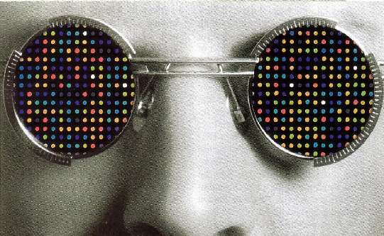
And for Imaging Technologies?
DNA arrays
“Quantitative” fluorescence assays
High Throughput assays (96-384 well plates)
Elispot
Drug effect assays
Toxicology assays
So: Example - simple animation – it works but the background is still nasty!

Slide 30
And for Imaging Technologies?
DNA arrays
“Quantitative” fluorescence assays
High Throughput assays (96-384 well plates)
Elispot
Drug effect assays
Toxicology assays
So: Example – gratuitous animation – plain annoying!!

Slide 31
Hydrodynamically focused fluidics
Signal
Increase pressure:
Widen core
Increase turbulence
So: You have to explain each step in the process – this animation needs time to do that – and the star on the right indicates how many mouse clicks to perform the entire animation sequence – add stars for each click necessary and animate them to disappear at each click

Slide 32
Use diagrams or flow charts if possible
Blocker 1
First Reactant
Intermediate
Last Reactant
Reagent A
Reagent C
Reagent B
So: Simple – very simple is good. Again, note the 3 stars on the right – these disappear after each mouse click – this way I know how many animation components there are in my slide. Remember this slide will take time to explain.
Note the stars indicating the number of mouse clicks left…

Slide 33
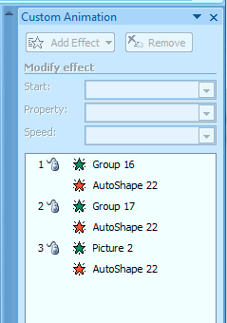
Animation helper
Place a small icon on the bottom of the screen to tell you how many steps there are in your animation.
+
=
So: Note the stars indicating the number of mouse clicks left…this helps to remind you of how many animation steps you have

Slide 34
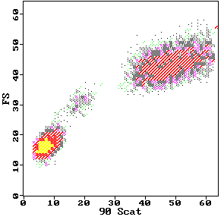
DCFH-DA DCFH DCF
2’,7’-dichlorofluorescin diacetate
O
O
CH3-C-O
O
O-C-CH3
Cl
Cl
2’,7’-dichlorofluorescin
H
COOH
HO
O
OH
Fluorescent
Cellular Esterases
Cl
Cl
H
COOH
2’,7’-dichlorofluorescein
Hydrolysis
HO
O
O
H₂O₂
Cl
Cl
DCFH-DA
Oxidation
H
COOH
Neutrophils
DCFH-DA
80
Monocytes
Control
PMA-stimulated PMN
60
DCFH
H O
counts
2 2
40
Lymphocytes
20
DCF
0
.1
1
10
100
1000
log FITC Fluorescence
So: This is pretty complex – it needs a long time to explain.

Slide 35
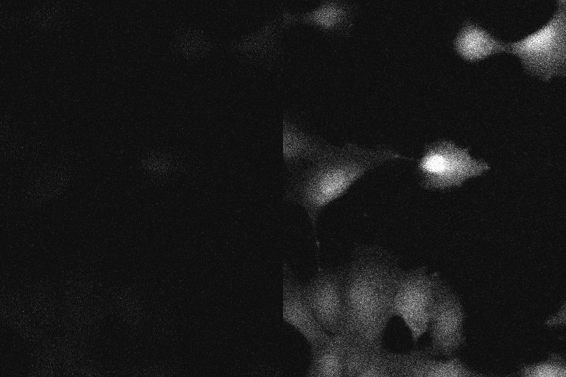
How a line scanning confocal works
A
Beam-splitting lens
B
1
1
2
2
Laser out
3
3
460 nm
405/35 nm
Cells in tissue culture disk are imaged on
an inverted microscope stage
Ratio: intensity1 (460nm) / intensity2 (405/35nm)
0.8
0.7
0.6
0.5
Scan width can be adjusted
Note that laser light is delivered
via a standard objective.
Ratio
0.4
0.3
0.2
0.1
Laser in
0
0
50
100
150
200
Time (seconds)
So: This is simple – it is very straightforward – explanation is easy but it will take some time – divide the slide into two parts, and run down the left, then move to the right side

Slide 36
Rat neutrophil oxidative burst
with nitric oxide modulators
12
Bars represent 1 SD mean
d
d
a
a
a,b,c,d
represent
statistical
significance
levels
8
a
4
b
c
0
HBSS
HBSS
TNFα
L-arg
L-arg
TNFα
L-NMMA
L-NMMA
ABC
NO modulators increase superoxide, TNF reduces O₂⁻
So: Basic data, very, very simple

Slide 37
Rat neutrophil oxidative burst
with nitric oxide modulators
12
Bars represent 1 SD mean
d
d
a
a
a,b,c,d
represent
statistical
significance
levels
8
a
4
b
c
0
HBSS
HBSS
TNFα
L-arg
L-arg
TNFα
L-NMMA
L-NMMA
ABC
NO modulators increase superoxide, TNF reduces O₂⁻
So: Basic data, but color enhanced…careful tho’ not to confuse what you are trying to explain. Do the colors add value to the data?

Slide 38
Rat neutrophil oxidative burst
with nitric oxide modulators
12
Bars represent 1 SD mean
d
d
a
a
a,b,c,d
represent
statistical
significance
levels
8
a
4
b
c
0
HBSS
HBSS
TNFα
L-arg
L-arg
TNFα
L-NMMA
L-NMMA
ABC
NO modulators increase superoxide, TNF reduces O₂⁻
So: Be careful when you use enhancement features which might look fun. This is OK, but much more would become very distracting.

Slide 39
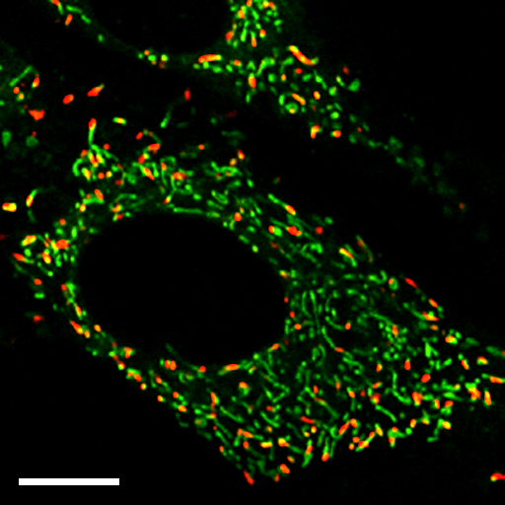
Rat neutrophil oxidative burst
with nitric oxide modulators
12
d
8
a
a
a
Mean EB Fluorescence
4
b
c
0
HBSS
HBSS
TNFα
L-arg
L-arg
TNFα
L-NMMA
L-NMMA
TNFα
NO modulators increase superoxide, TNK reduces O₂⁻
Pinhole 1
Pinhole 2
Specimen
Detector
Condenser
Lens
Objective
Lens
So: This is overboard – background is horribly distracting, and it’s just a bad slide. The audience is wincing…..it’s not acceptable!!

Slide 40
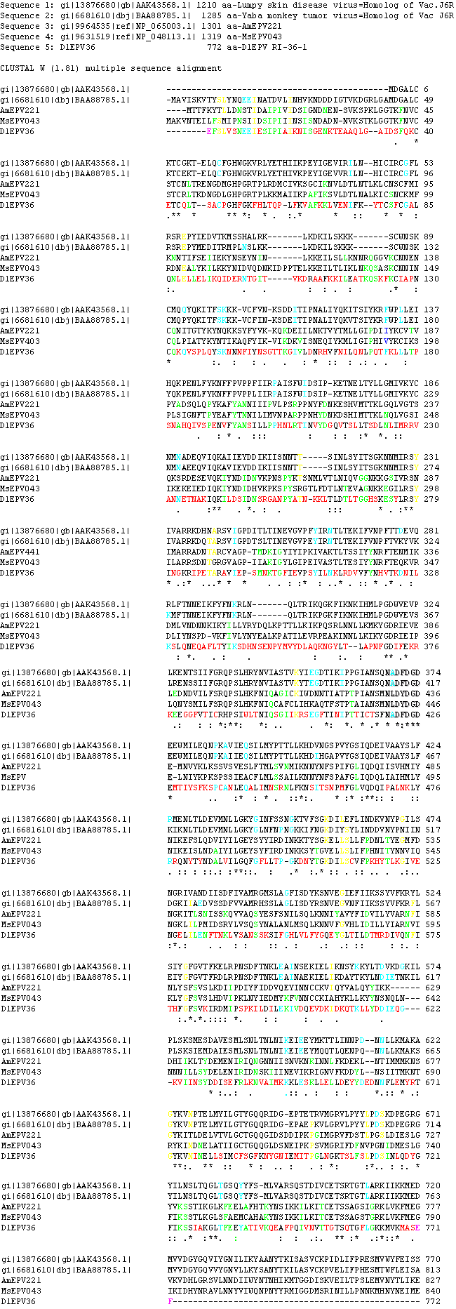
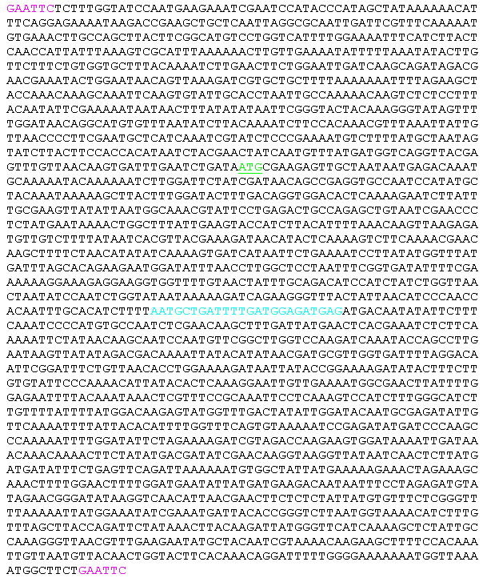
Data Slides
Here is something important…..
So: No – bad idea – if you have to tell the audience “..I know you can’t read this….but….” - don’t show it. This is a totally unacceptable slide!! NOTE: For PDF versions you will not see that the entire slide which has a huge sequence all over it - you can’t read anything!!

Slide 41
Some things you should know about projectors and computers
All projectors should be considered the “enemy”
All projectors are different
There are often 3 modes for your computer
  Mode 1: Laptop screen only
  Mode 2: Laptop and external monitor (Projector) (Fn/F8)
  Mode 3: External monitor (projector) only (Fn/F8)
Be careful using Mode 2 – Movies may not play on the projector
At most meetings, KVM switches are used to connect laptops – regardless, you must pre-check the system out
So: Bottom line is check out the projector with ALL your slides before you give the presentation….make sure your movies work! How many times have I seen presentations where movies don’t work? .… HUNDREDS!!

Slide 42
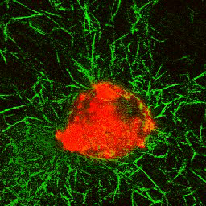
Example of movie not playing in mode 2
The movie on the right plays OK on mode 2 but may not play on the projector. Some newer computers will play it regardless. When you copy your presentation to another computer…chances are the movies wont work. Use the “Package for CD” setting under FILE in PowerpointTM
So: It’s a great movie, but when it does not work and you say “…well if you were able to see this movie, you would see...”.…it’s not good!

Slide 43
How Many Slides?
Rule of thumb: Use 1 slide per minute of your allotted time including your opening and closing slides.
You will spend much longer on some slides than you think.
For a 20-minute talk, I suggest only 20 slides. If you fill up your 20 minutes, there is no time for questions.
Don’t you hate being the last speaker in a session where everyone has gone 5 minutes over and your 30-minute talk now has 15 minutes left? Don’t do that to other speakers!!
This presentation was designed for a 45-50 minute talk with 10-15 minutes for discussion. There are 44 slides in the actual presentation.
The last 2 slides are explanations as to how the slides were made – an example of adding extra slides in case a question is asked about a topic. Slide #2 was added to give some “online” explanation. This is not shown in the seminar.
So: 90 slides for a 45 minute presentation says “I am going to blow you away with data, but I don’t care if you really understand what I am saying. My huge number of slides says ‘I can’t organize myself!’”

Slide 44
Answering Questions
Listen carefully to the question
Do not interrupt or finish the question for the questioner
Repeat the question for the audience in shortened form
If you do not know the answer or how to approach, ask for more guidance
  e.g. “I am not sure I understand the question, could you elaborate.”
If you then do not know the answer, don’t ramble, try this:
  “I am not sure of the answer, but one possible reason might be”
  “I’d be happy to get back to you with the answer to your question after I do some research on the issue”
You can also shift the responsibility to your supervisor/boss if you are not sure what to do
  e.g. “Perhaps Professor X can answer that better than I”
NEVER argue with questioners…if they become really “pushy” and are being difficult just say
  “Perhaps we can talk about this after the seminar”
  You always have the option of simply saying
  “I don’t know the answer to your question at this stage!”

Slide 45
Summary
A good presentation requires much preparation
Make a proper introduction and use a slide that shows the structure of your talk
Have slides that are clean, clear, and readable
Use approximately 1 slide per minute
Show a summary slide at the end
Make the final slide an acknowledgement slide
Add a few extra slides AFTER your last slide to use in case questions arise in those areas
Conclude by saying : “Thank you very much for your attention.” Stop and let the audience clap!!!
It’s NOT your right to ask for questions!!!
What do you think about asking for questions?
So: Do NOT ask for questions!!

Slide 46
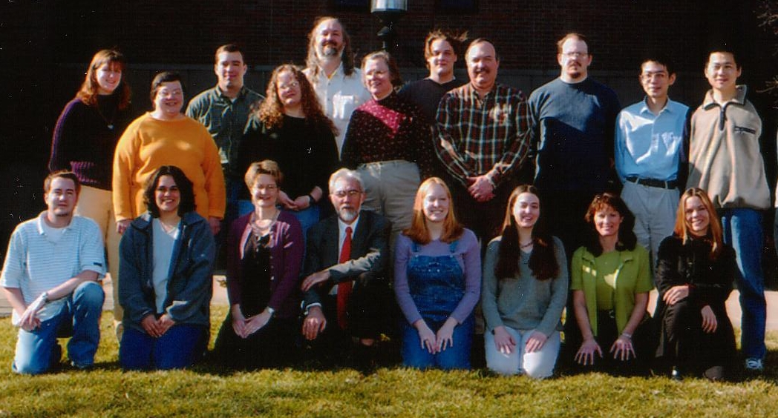
Acknowledgements
Tissue Engineering Studies
  Sherry Harbin
  Blayne Roeder
  Alaina Pizzo
  Klod Kokini
  Jennie Sturgis
  Bartek Rajwa
  Bev Waisner
Microbiology/Biofilms
  Stephanie Sincock
  John Thomas
  Gerald Gregori
  Kathy Ragheb
Oxidative Metabolism Studies
  Carl-Fredrick Bassoe
  Nianyu Li
  Kathy Ragheb
  Gretchen Lawler
Funding Sources
  National Institutes for Health
  National Science Foundation
  Any company you received funds, Inc
So: List names of those who contributed to the work. Also list your funding sources, and acknowledge any companies that contributed. People must know if your work has been funded by a corporate sponsor. It’s the law to identify them if you work is federally funded!

Slide 47
How were the Printouts Prepared?
Slides were made in PowerPointTM
They were “printed” to Adobe AcrobatTM to create a PDF file
The PDF was printed 6 per page, framed in Acrobat, which allows you to fill the page
This gives a larger slide than printing directly to the printer from PowerPoint

Slide 48
Features that can be added
You can place these features using
“Slide Master” – but note that PPT differentiates between different “masters” so you can actually have many different styles that complicate these features (this presentation has many styles as I tool slides from different presentations)
A copyright statement is added using Header & Footer
Slide number is added using Header & Footer
(I know – 48 of 46 sides is an odd number!)
A clock can be added that shows real time by using Header & Footer and activating update in real time

Slide 49
About this Presentation
It was designed to assist graduate students to create quality presentations
You may copy this and use it for any purpose, it may not be commercialized
If you do use it, please acknowledge the source as:
J. Paul Robinson, Ph.D.
Professor, Purdue University
Email: jpr@flowcyt.cyto.purdue.edu
Web: www.cyto.purdue.edu
The actual presentation is at http://www.cyto.purdue.edu/Education/index.htm
This talk has been presented several times since 2000. This current version 06/02/10

