Slide 1

BMS 631: Lecture 4
Fluorescence
J. Paul Robinson, PhD
The SVM Professor of Cytomics &
Professor of Biomedical Engineering
Purdue University
www.cyto.purdue.edu
Notice: The materials in this presentation are copyrighted materials. If you want to use any of these slides, you may do so if you credit each slide with the author’s name. It is illegal to place these notes on CourseHero.
All materials used in this course are available for download on the web at
http://tinyurl.com/2wkpp
Last updated Feb, 2022

Slide 2
Absorption
Basic quantum mechanics requires that molecules absorb energy as quanta (photons) based upon a criteria specific for each molecular structure
Absorption of a photon raises the molecule from ground state to an excited state
Total energy is the sum of all components (electronic, vibrational, rotational, translations, spin orientation energies) (vibrational energies are quite small)
Absorption spectrum of FITC
3rd Ed Shapiro p 84

Slide 3
Fluorophores have different absorption properties
The structure of the molecule dictates the likely-hood of absorption of energy to raise the energy state to an excited one
Calcein
FITC

Slide 4
Lifetime
Absorption associated with electronic transitions (electrons changing states) occurs in about 1 femtosecond (10⁻¹⁵ s)
The lifetime of a molecule depends on how the molecule disposes of the extra energy – but many fluorophores have lifetimes around 5 ns
Because of the uncertainty principle, the more rapidly the energy is changing, the less precisely we can define the energy
So, long-lifetime-excited-states have narrow absorption peaks, and short-lifetime-excited-states have broad absorption peaks
3rd Ed. Shapiro p 85
4th Ed. Shapiro p 110
Notes:
Its useful to understand that the lifetime of many of the fluorophores is very short – when I say short, I mean really short – many are around 5-10 nanoseconds…

Slide 5
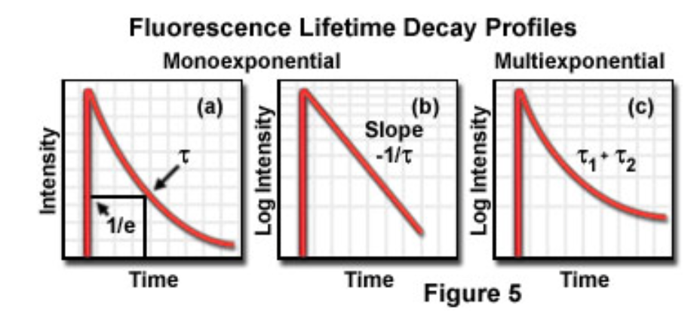
Fluorescence Lifetime
Absorption associated with electronic transitions (electrons changing states) occurs in about 1 femptosecond (10⁻¹⁵ s)
Fluorescence lifetime is defined as the time in which the initial fluorescence intensity of a fluorophore decays to 1/e (approx 37 percent) of the initial intensity
The lifetime of a molecule depends on how the molecule disposes of the extra energy
Because of the uncertainty principle, the more rapidly the energy is changing, the less precisely we can define the energy
So, long-lifetime-excited-states have narrow absorption peaks, and short-lifetime-excited-states have broad absorption peaks
http://micro.magnet.fsu.edu/primer/techniques/fluorescence/fluorescenceintro.html
Shapiro p 85

Slide 6
Fluorescence Lifetimes
https://www.ncbi.nlm.nih.gov/pmc/articles/PMC2924670/

Slide 7
Fluorescence Lifetimes
http://www.iss.com/resources/reference/data_tables/LifetimeDataFluorophores.html

Slide 8
Exctinction
Using Beer’s law (Beer-Lambert law) for light travelling through a curvette thickness d cm containing n molecules/cm³
  ln (I_{o}/I) = σnd
    where Io and I are the light entering and leaving and σ is the molecular property called the absorption cross section
Now we can state that
  ln (I_{o}/I) = σnd where C is the concentration and σ is the absorption coefficient which reflects the capacity of the absorbing substance to absorb light
If there are n (molecules/cm³ ; d in cm, σ must be in cm² so if σ is in cm²/mol, C must be in mol/cm³ so C= σ/10³
giving
  log10 (I_{o}/I) = εαd = A
  where A is the absorbance or optical density
  and ε is the decadic molar exctinction coeficient in dm³mol⁻¹cm⁻¹
Shapiro p 86

Slide 9
Absorbance
O.D. units or absorbance is expressed in logarithmic terms so they are additive.
e.g. an object of O.D. of 1.0 absorbs 90% of the light. Another object of O.D. 1.0 placed in the path of the 10% of the light 10% of this light or 1% of the original light is transmitted by the second object
It is possible to express the absorbance of a mixture of substances at a particular wavelength as the sum of the absorbances of the components
You can calculate the cross sectional area of a molecule to determine how efficient it will absorb photons. The extinction coefficient indicates this value
3rd ed. Shapiro p 87
4th Ed. Shapiro p 111
Notes:
OD – or optical density – or absorbance is important as it impacts many aspects of cytometyr. One is that we do need to appreciate how we reduce the amount of light when we need to. One way is to use optical filters that reduce intensity in anon-spectrally dependent fashion. That means, they reduce all bands pretty much at the same rate. Absorbance is expressed in logarithmic terms so its easy to undestand how adding neutral density filters works – so for an OD of 1.0, 90% of the light is absorbed….and if we add another filter exactly the same, we again reduce this by a factor of 10, so we end up with 1% and so on.
Wehen we look at how absorbance works in molecules, we can caluclate the cross sectional area of the molecule and this will tell us how efficent that mlecule will absorb photons thrown at it from the laser excitation. This value is the extinction coefficent.

Slide 10
Parameters
Extinction Coefficient
  ε refers to a single wavelength (usually the absorption maximum) …the cross sectional area of a molecule determines how efficient it will absorb photons
Quantum Yield
  Q_{f} is a measure of the integrated photon emission over the fluorophore spectral band
At sub-saturation excitation rates, fluorescence intensity is proportional to the product of ε and Q_{f}
ε

Slide 11
Fluorescence
Quantum Yield
photons emitted
photons absorbed
k_{r}
k_{r} + k_{nr}
Q =
=
Fluorescence Lifetime (τ)
  - is the time delay between the absorbance and the emission
1
k_{r} + k_{nr}
τ
=
R - reactant molecules)

Slide 12
Fluorescence
Photon emission as an electron returns from an excited state to ground state
Ground State: Electrons are in positions of lowers energy
Stable
Excited State: Electron is in a temporarily position of higher energy and is very unstable and desperately wants to return to ground state in positions of lowers energy
Unstable

Slide 13


Slide 14
Fluorescence
Excitation Spectrum
  Intensity of emission as a function of exciting wavelength (this is the absorbance component)
Super efficient excitation here
OK
efficiency here
Inefficient here

Slide 15
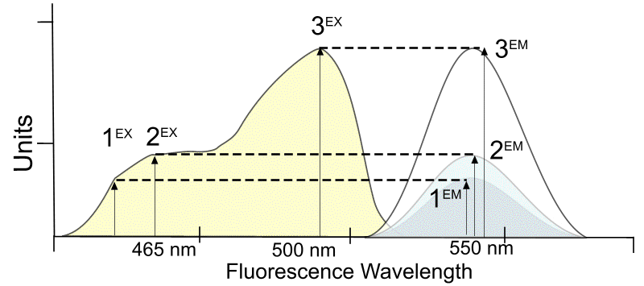
About excitation
Intensity of emission as a function of exciting wavelength
More efficient excitation results in more signal!!

Slide 16
Fluorescence
Chromophores are components of molecules which absorb light
They are frequently aromatic rings
or similar
FITC
Calcein
Hoechst

Slide 17
Fluorescence
The wavelength of absorption is related to the size of the chromophores
Smaller chromophores, higher energy (shorter wavelength)
Texas Red has to be excited up here
CAS Number‎: ‎28718-90-3
Molar mass‎: ‎277.33 g·mol⁻¹
Chemical formula‎: ‎C₁₆H₁₅N₅
Chemical formula‎: ‎C₃₁H₂₉ClN₂O₆S₂
Molar mass‎: ‎625.15 g·mol⁻¹
CAS Number‎: ‎82354-19-6
ChEBI‎: ‎CHEBI:51247
DAPI
Texas Red

Slide 18
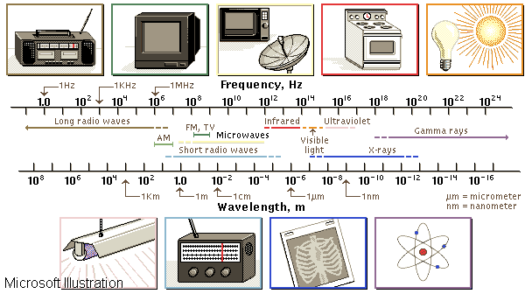
Electromagnetic Spectrum
© Microsoft Corp, 1995
Only a very small region within the ES
is used for flow cytometry applications
Notes:
Arc lamps and lasers
for flow cytometry
restricted to this region

Slide 19
Properties of Fluorescent Molecules
Large extinction coefficient at the region of excitation
High quantum yield
Optimal excitation wavelength
Photostability
Excited-state lifetime
Minimal perturbation by probe

Slide 20
Simplified Jablonski Diagram
S’₁
S₁
Energy
hv_{ex}
hv_{em}
S₀

Slide 21
Fluorescence
Jablonski Diagram
Singlet States
Triplet States
S₂
Vibrational energy levels
Rotational energy levels
Electronic energy levels
T₂
S₁
ENERGY
IsC
T₁
ABS
FL
I.C.
PH
IsC
S₀
[Vibrational sublevels]
3rd Ed. Shapiro p 87
4th Ed. Shapiro p 112
ABS - Absorbance S 0.1.2 - Singlet Electronic Energy Levels
FL - Fluorescence T 1,2 - Corresponding Triplet States
I.C.- Nonradiative Internal Conversion IsC - Intersystem Crossing PH - Phosphorescence

Slide 22
Fluorescence
Stokes Shift
  is the energy difference between the lowest energy peak of absorbance and the highest energy of emission
Fluorescein
molecule
Stokes Shift is 20 + nm
495 nm
518 nm
Fluorescnece Intensity
Wavelength

Slide 23
Fluorescence
The longer the wavelength the lower the energy
The shorter the wavelength the higher the energy
  eg. UV light from sun - this causes the sunburn, not the red visible light

Slide 24
Fluorescence Excitation Spectra
Intensity
related to the probability of the event
Wavelength
  the energy of the light absorbed or emitted

Slide 25
Conclusions
Dye molecules must be close to but below saturation levels for optimum emission
Fluorescence emission is longer than the exciting wavelength
The energy of the light increases with reduction of wavelength

Slide 26
Relative absorbance of phycobiliproteins
Phycobiliproteins are stable and highly soluble proteins derived from cyanobacteria and eukaryotic algae with quantum yields up to 0.98 and molar extinction coefficients of up to 2.4 × 10⁶ (ABS=Absorbance)
Protein | 488nm % ABS | 568nm % ABS | 633nm % ABS
B-phycoerytherin | 33 | 97 | 0
R-phycoerytherin | 63 | 92 | 0
allophycocyanin | 0.5 | 20 | 56
Data from Molecular Probes Website

Slide 27
Allophycocyanin (APC)
Protein
632.5 nm (HeNe)
300 nm 400 nm 500 nm 600 nm 700 nm
Excitation
Emission

Slide 28
Some Common Laser lines
350
457
488
514
610
632
Common Laser Lines
300 nm
400 nm
500 nm
600 nm
700 nm
PE-TR Conj.
Texas Red
PI
Ethidium
PE
FITC
325nm
cis-Parinaric acid

Slide 29
Quenching, Bleaching & Saturation
Quenching is when excited molecules relax to ground states via nonradiative pathways avoiding fluorescence emission (vibration, collision, intersystem crossing)
Molecular oxygen quenches by increasing the probability of intersystem crossing
Polar solvents such as water generally quench fluorescence by orienting around the exited state dipoles
3rd Ed. Shapiro p 90
4th Ed. Shapiro p 115

Slide 30
Photobleaching
Defined as the irreversible destruction of an excited fluorophore
Photobleaching is not a big problem for flow cytometry as long as the time window for excitation is very short (a few hundred microsconds)

Slide 31
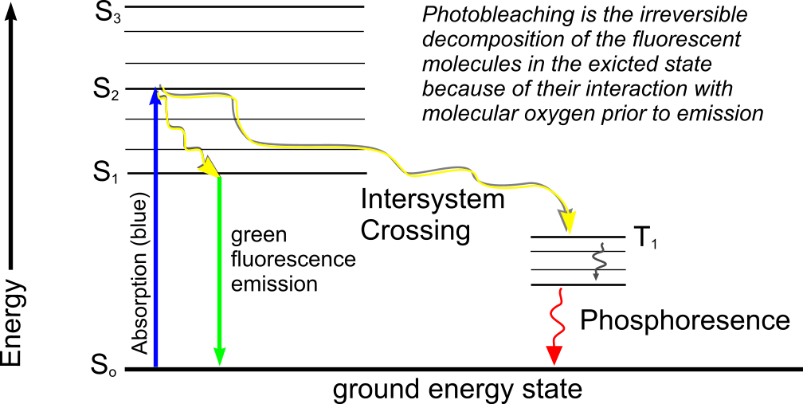
Fluorescence

Slide 32
Photobleaching example from microscopy
FITC - at 4.4 x 10²³ photons cm⁻² sec⁻¹ FITC bleaches with a quantum efficiency Q_{b} of 3 x 10⁻⁵
Therefore FITC would be bleaching with a rate constant of 4.2 x 10³ sec⁻¹ so 37% of the molecules would remain after 240 μsec of irradiation.
In a single plane, 16 scans would cause 6-50% bleaching

Slide 33
Excitation Saturation
The rate of emission is dependent upon the time the molecule remains within the excitation state (the excited state lifetime τ_{f})
Optical saturation occurs when the rate of excitation exceeds the reciprocal of τ_{f}
(Microscopy example) In a scanned image of 512 x 768 pixels (400,000 pixels) if scanned in 1 second requires a dwell time per pixel of 2 x 10⁻⁶ sec.
Molecules that remain in the excitation beam for extended periods have higher probability of interstate crossings and thus phosphorescence – fortunately this rarely happens in flow cytometry
Usually, increasing dye concentration can be the most effective means of increasing signal when energy is not the limiting factor (i.e. laser based confocal systems)

Slide 34
Phosphorescence
Following absorption, molecules can relax via a non-radiative transition to the T₁ rather than the S₁ state - this is called an intersystem crossing
While it is forbidden it does happen and has a low probability and takes a longer time - the energy dissipated is called phosphorescence
Phosphorescence has a longer lifetime than fluorescence (milliseconds rather than femtoseconds)
Phosphorescence generally occurs at longer wavelengths than fluorescence because the energy difference between S₀ and T₁ is lower
3rd Ed Shapiro p 88
4th Ed. Shapiro p 113

Slide 35
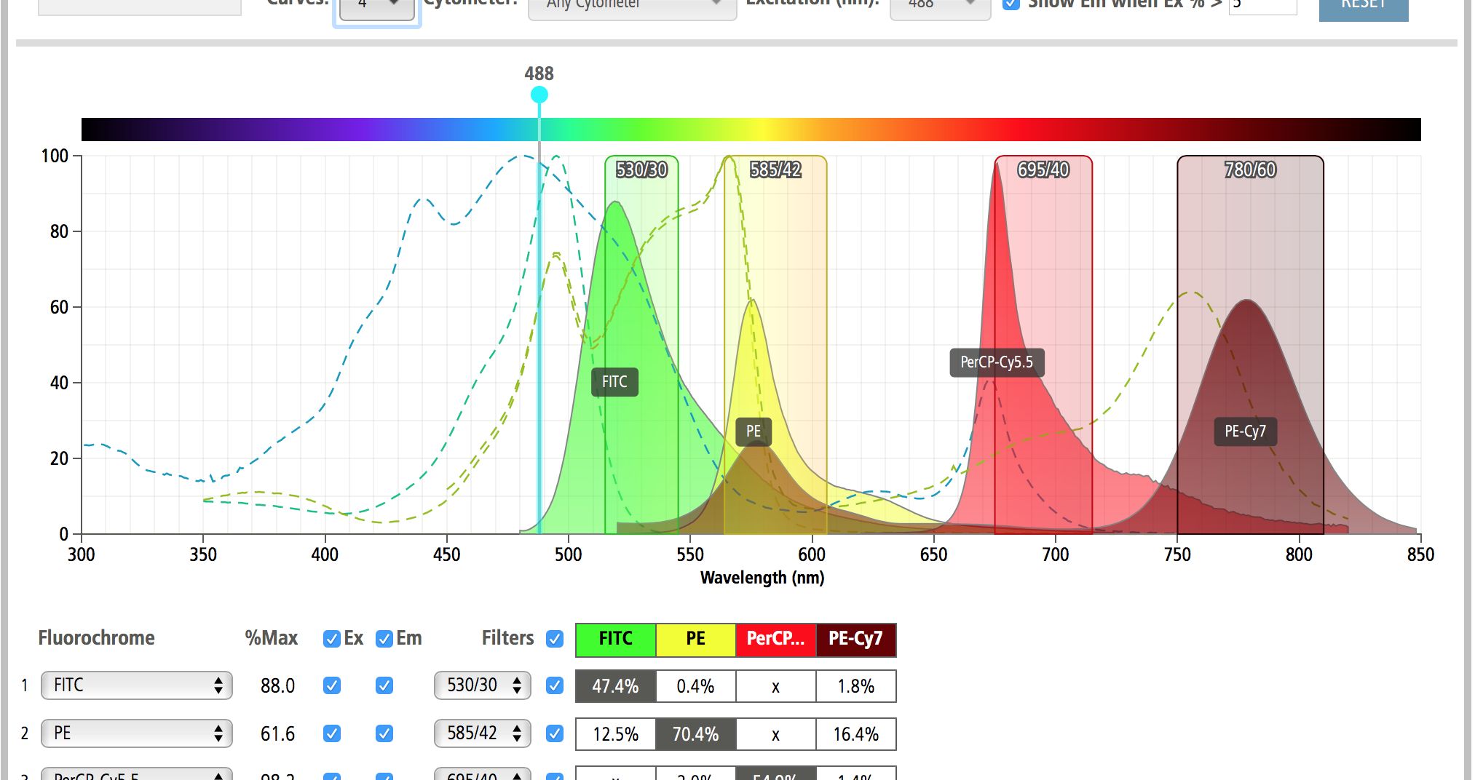
Fluorochrome excitation and emission spectra
Typical fluorchromes
FITC
PE
PerCP-Cy5.5
PE-Cy7
http://m.bdbiosciences.com/us/s/spectrumviewer

Slide 36
Excitation - Emission Peaks
You should select fluorophores that match the laser excitation you have – and try to make sure they are not excited by other lines
% Max Excitation at
488 568 647 nm
Fluorophore EX_{peak} EM _{peak}
FITC 496 518 87 0 0
Bodipy 503 511 58 1 1
Tetra-M-Rho 554 576 10 61 0
L-Rhodamine 572 590 5 92 0
Texas Red 592 610 3 45 1
CY5 649 666 1 11 98
Note: You will not be able to see CY5 fluorescence under the regular fluorescent microscope because the wavelength is too long.

Slide 37
Excitation Efficiency

Slide 38
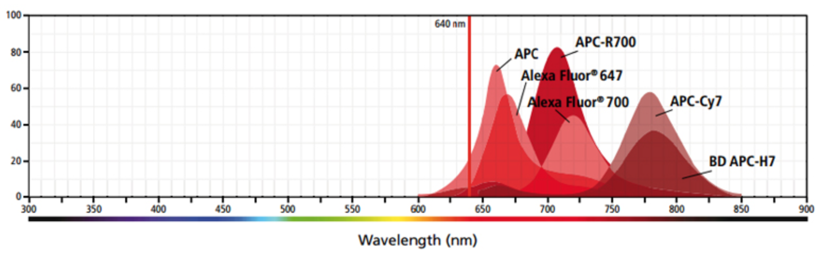
The problem of spectral overlap
From BD Spectra viewer

Slide 39
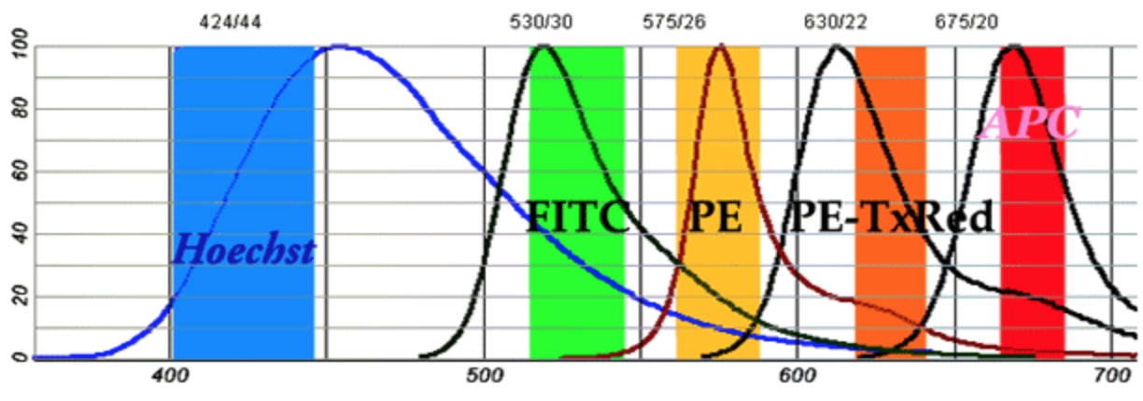
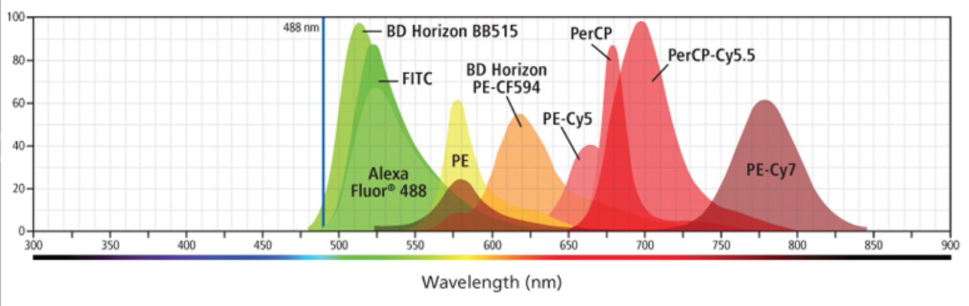
From BD Spectra viewer

Slide 40
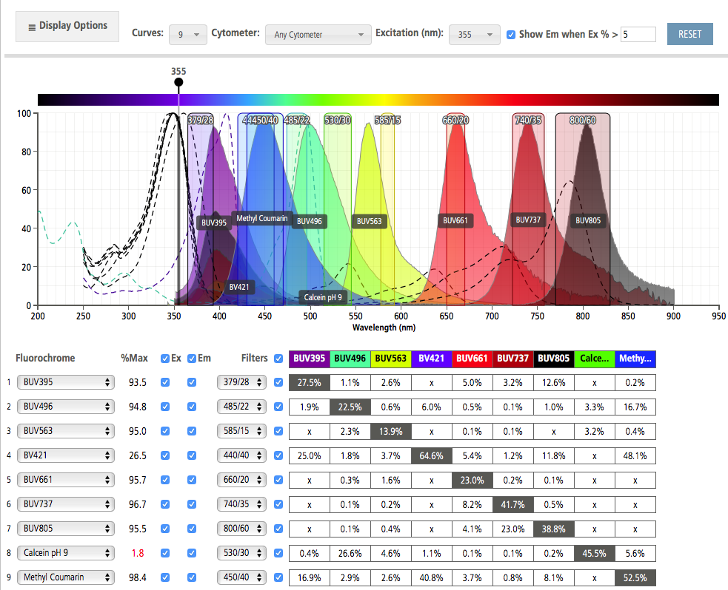

Slide 41
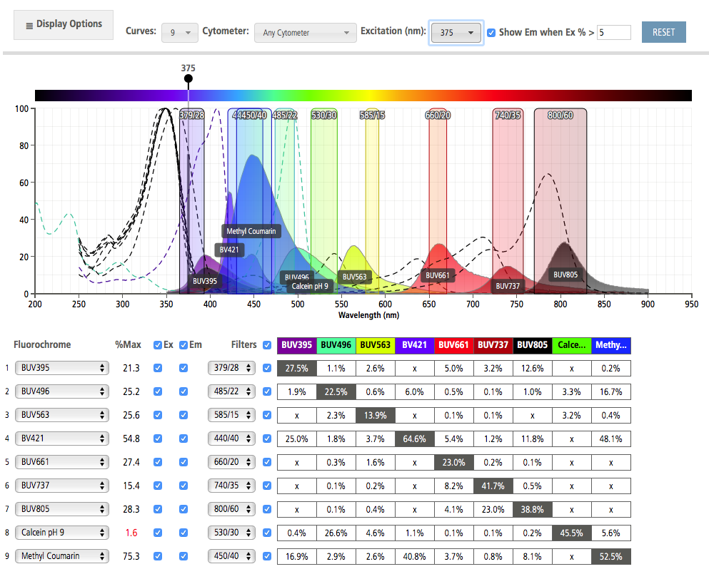

Slide 42
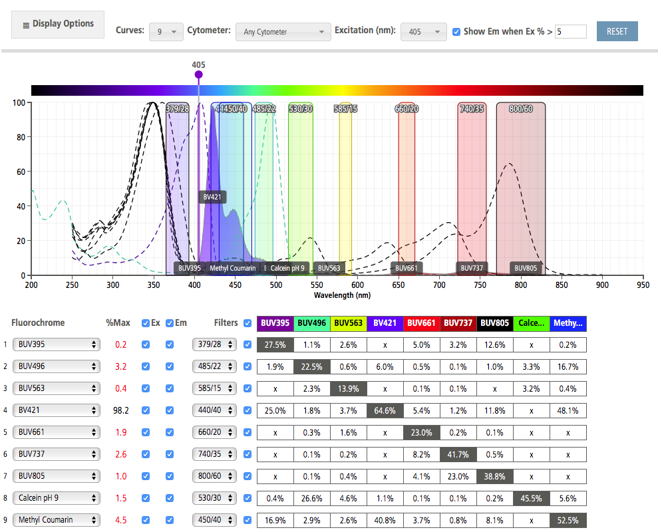

Slide 43
Resonance Energy Transfer
Resonance energy transfer can occur when the donor and acceptor molecules are less than 100 Å of one another (preferable 20-50 Å)
Energy transfer is non-radiative which means the donor is not emitting a photon which is absorbed by the acceptor
Förster (Fluorescence) RET (FRET) can be used to spectrally shift the fluorescence emission of a molecular combination.
3rd Ed. Shapiro p 90
4th Ed. Shapiro p 115

Slide 44
FRET properties
Isolated donor
Donor distance too great
Donor distance correct

Slide 45
Fluorescence Förster Resonance Energy Transfer (FRET)
Molecule 1
Molecule 2
Fluorescence
of acceptor after
excitation by donor
DONOR
Fluorescence
of donor
ACCEPTOR
Absorbance
of acceptor
molecule
Intensity
Absorbance
of donor
Laser line 488nm
550nm
600nm
650nm
Wavelength

Slide 46
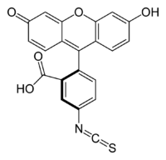
Note added of interest
First synthesis of fluorescein:
A. Von Baeyer, Ber Deutch Chem Ges 4:555. 1871
Recent uses of fluorescent protein molecules FUCCI
Fluorescent Ubiqutination based cell cycle Indicator
(fluorescent protein-based system that employs both a red (RFP) and a green (GFP) fluorescent protein fused to different regulators of the cell cycle: cdt1 and geminin. )
From Invitrogen website:
Developed by Miyawaki and colleagues¹, the fluorescence ubiquitination cell cycle indicator (FUCCI), is a genetically encoded, two-color (red and green), indicator that lets you follow cell division within a cell population. We have incorporated the FUCCI genetic constructs into the powerful BacMam gene delivery system, creating a simple and efficient method for labeling cells and following their division:
Population-level, real-time cell cycle phase determination
Easy and efficient labeling through BacMam gene delivery system
Fluorescein is an organic dye also known as D & C Yellow No. 7 and many other names. A. von Baeyer first synthesized it in 1871 from phthalic anhydride and resorcinol and called it resorcinphthalein. It is not soluble in water or many organic solvents, but its disodium salt (fluorescein sodium, uranine, D & C Yellow No. 8) is highly water-soluble.
Johann von Baeyer
1835-1917
1905 Nobel Prize in Chemistry
https://www.acs.org/content/acs/en/molecule-of-the-week/archive/f/fluorescein.html
WIKI
(chemical formula C₂₀H₁₂O₅)
Lifetime 3 ns MWt 332.32
Fluorescein isothiocyanate
http://cell.firstlightera.com/EN/Microsites/1/Invitrogen/PremoFUCCI
1. Sakaue-Sawano et al. (2008) Cell 132:487–498

Slide 47
Raman Scatter
A molecule may undergo a vibrational transition (not an electronic shift) at exactly the same time as scattering occurs
This results in a photon emission of a photon differing in energy from the energy of the incident photon by the amount of the above energy - this is Raman scattering.
The dominant effect in flow cytometry is the stretch of the O-H bonds of water. At 488 nm excitation this would give emission at 575-595 nm
Can use surface enhance Raman Scattering
Can use antibody-targeted, PEG-coated surface-enhanced Raman scattering (SERS) Au nanoparticles are used to label antigens
Langmuir 2013, 29, 6, 1908-1919
3rd Ed. Shapiro p 93
4th Ed. Shapiro p 118

Slide 48
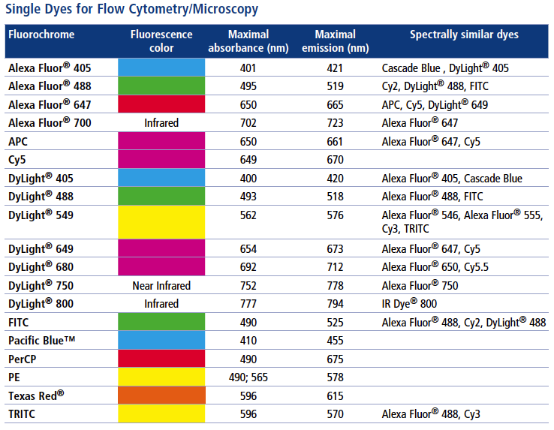

Slide 49
Probes for Proteins
Probe Excitation Emission
FITC 488 525
PE 488 575
APC 630 650
PerCP™ 488 680
Cascade Blue 360 450
Coumerin-phalloidin 350 450
Texas Red™ 610 630
Tetramethylrhodamine-amines 550 575
CY3 (indotrimethinecyanines) 540 575
CY5 (indopentamethinecyanines) 640 670

Slide 50
Specific Organelle Probes
Probe Site Excitation Emission
BODIPY Golgi 505 511
NBD Golgi 488 525
DPH Lipid 350 420
TMA-DPH Lipid 350 420
Rhodamine 123 Mitochondria 488 525
DiO Lipid 488 500
diI-Cn-(5) Lipid 550 565
diO-Cn-(3) Lipid 488 500
BODIPY - borate-dipyrromethene complexes
NBD - nitrobenzoxadiazole
DPH - diphenylhexatriene
TMA - trimethylammonium

Slide 51
Fluorescence Overlap

Slide 52
Fluorescence Overlap

Slide 53
Fluorescence Overlap
This is your bandpass filter
Overlap of FITC fluorescence in PE PMT
a
Overlap of PE fluorescence in FITC PMT
b

Slide 54
Fluorescence
The longer the wavelength the lower the energy
The shorter the wavelength the higher the energy
  eg. UV light from sun - this causes the sunburn, not the red visible light
The spectrum is independent of precise excitation line but the intensity of emission is not

Slide 55

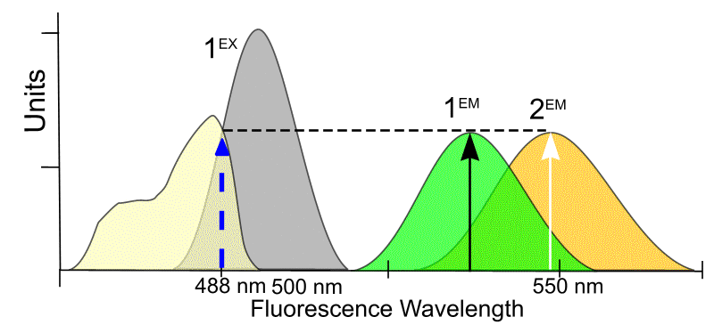
Mixing fluorochromes
When there are two molecules with different absorption spectra, it is important to consider where a fixed wavelength excitation should be placed. It is possible to increase or decrease the sensitivity of one molecule or another.

Slide 56
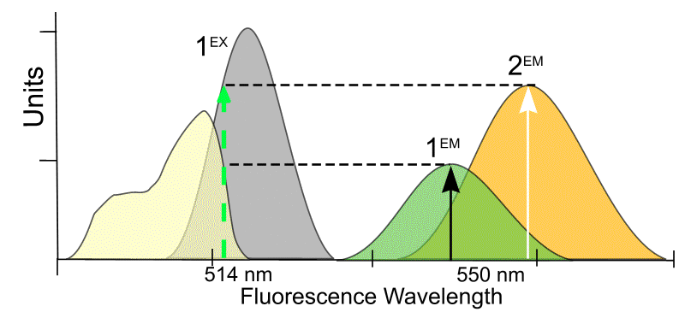
Mixing fluorochromes
When there are two molecules with different absorption spectra, it is important to consider where a fixed wavelength excitation should be placed. It is possible to increase or decrease the sensitivity of one molecule or another.

Slide 57
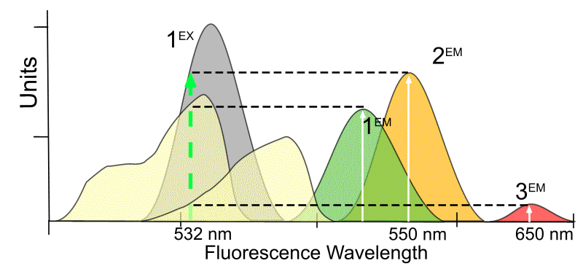
Mixing fluorochromes
When there are two molecules with different absorption spectra, it is important to consider where a fixed wavelength excitation should be placed. It is possible to increase or decrease the sensitivity of one molecule or another.

Slide 58
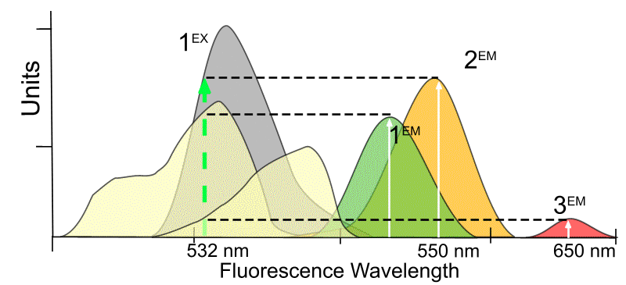
Excitation of 3 Dyes with emission spectra
J. Paul Robinson, Class lecture notes, BMS 631

Slide 59
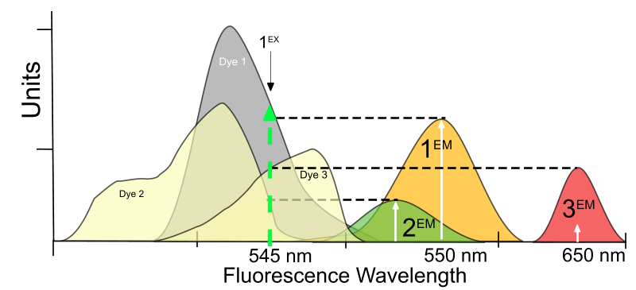
Change of Excitation
J. Paul Robinson, Class lecture notes, BMS 631

Slide 60
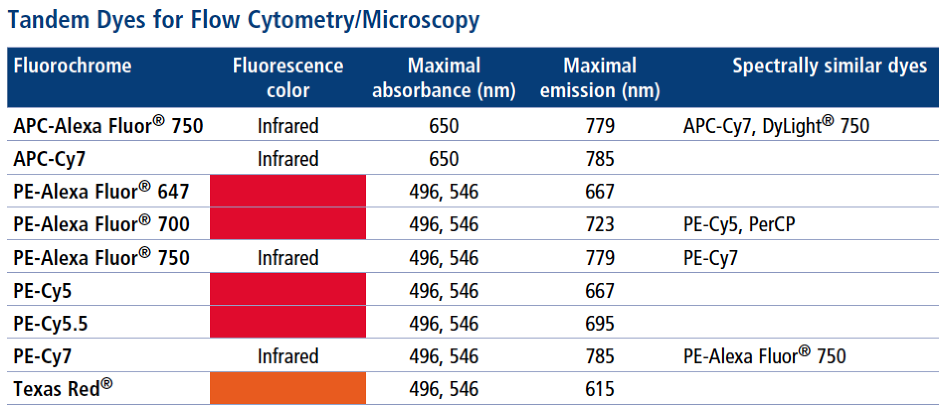
Tandem conjugates

Slide 61
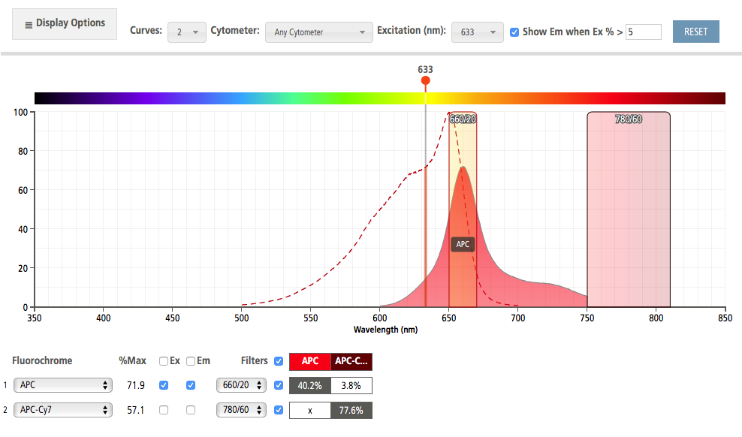
APC is exited nicely by 632 nm
From BD Spectra viewer

Slide 62
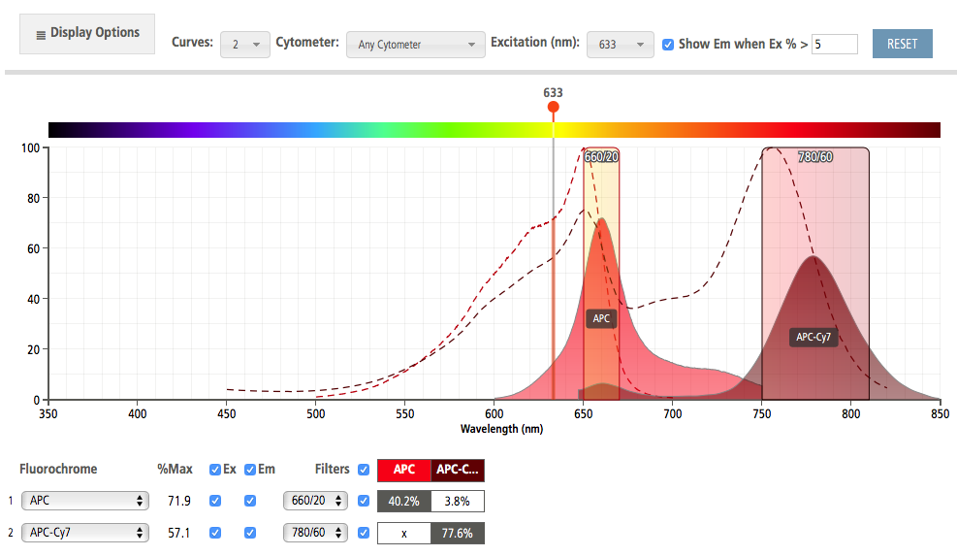
APC and the Tandem
From BD Spectra viewer

Slide 63
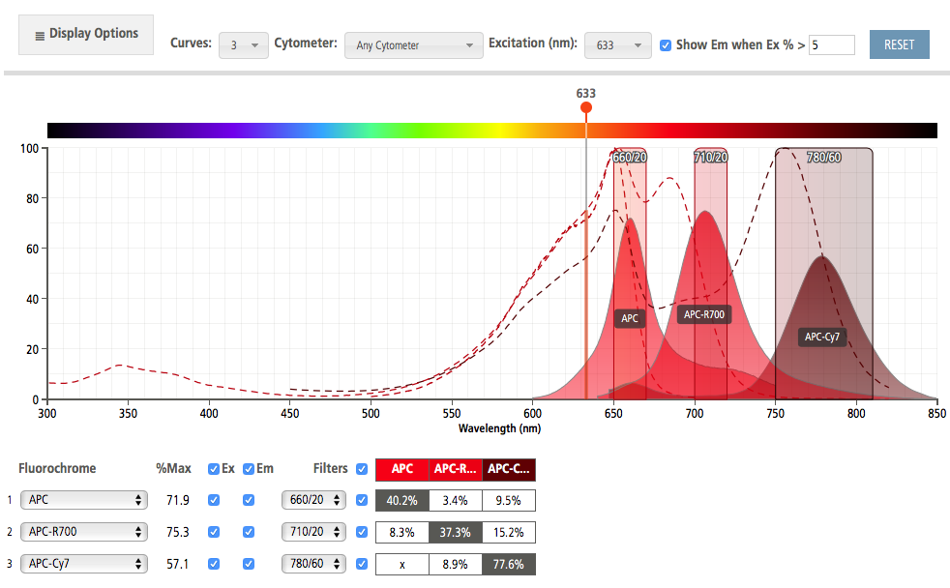
And now with 3 probes from 632 nm
From BD Spectra viewer

Slide 64
And now with 3 probes from 561 nm

Slide 65
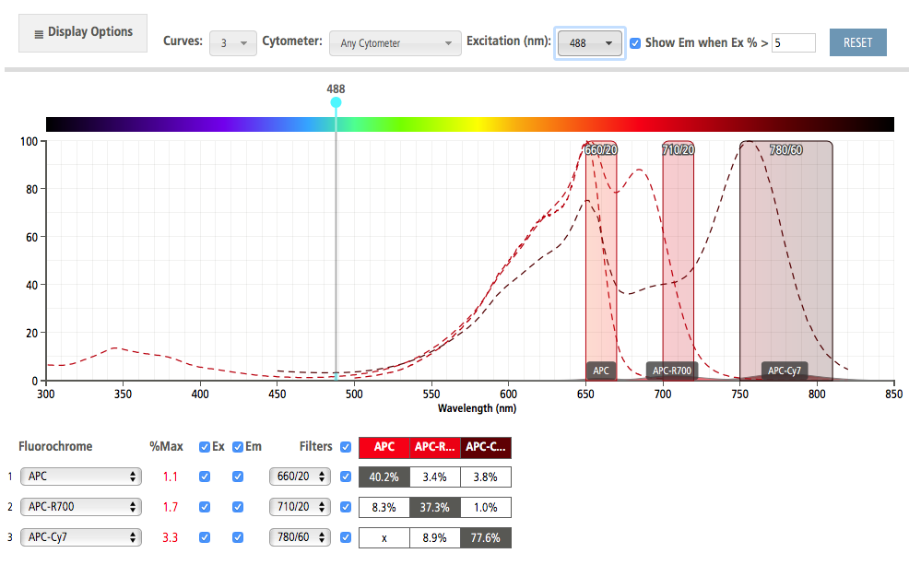
Change Excitation – nothing!
From BD Spectra viewer

Slide 66
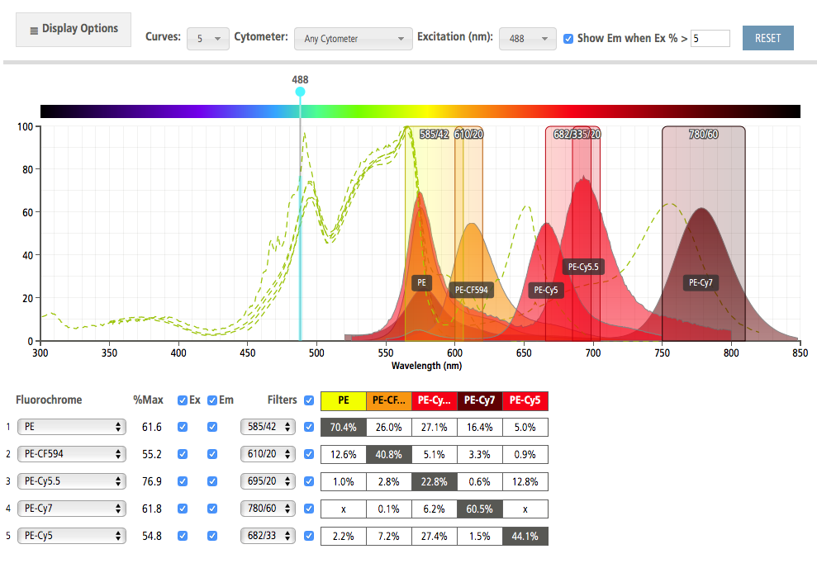
PE-tandems
From BD Spectra viewer

Slide 67
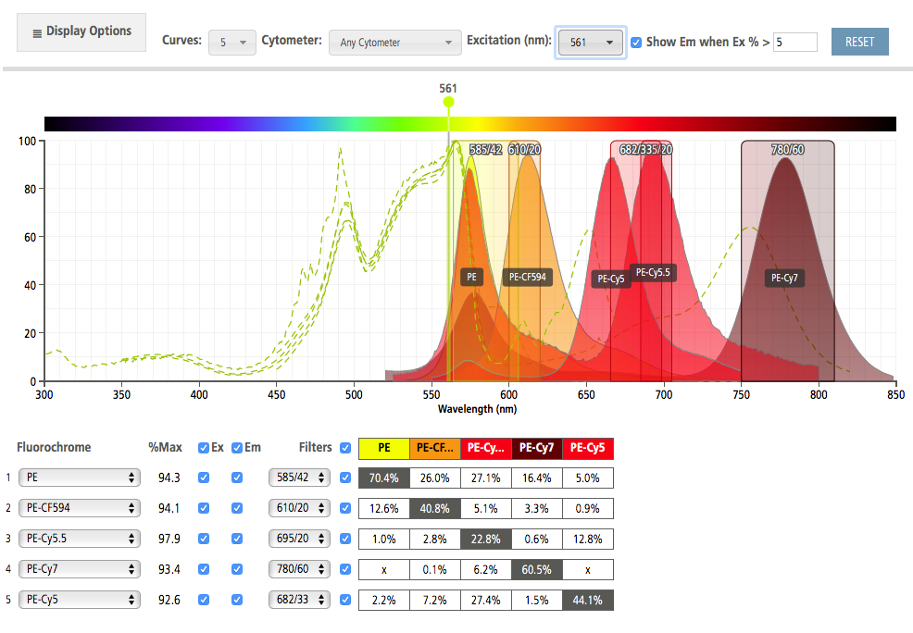
PE Tandems with 561 Excitation – more efficient
From BD Spectra viewer

Slide 68
We can learn about dyes and filters by going to several sites to reveal properties
BioLegend: https://www.biolegend.com/spectraanalyzer
BD: http://www.bdbiosciences.com/us/s/spectrumviewer
Thermo: https://www.thermofisher.com/us/en/home/life-science/cell-analysis/labeling-chemistry/fluorescence-spectraviewer.html
Chroma: https://www.chroma.com/spectra-viewer
Sigma: https://www.sigmaaldrich.com/labware/learning-center/spectral-viewer.html
Evrogen: http://evrogen.com/spectra-viewer/viewer.shtml
Expedeon: https://www.expedeon.com/resources/applications/flow-cytometry/new-fluorescence-spectra-viewer/
Fluorophoresorg: http://www.fluorophores.tugraz.at/substance/
Semrock: https://searchlight.semrock.com

Slide 69
DNA analysis – using PI
Other basic fluorescence applications- PI is an intercalating agent
Cell #
The basis for this working is that there is a relationship between the number of molecules of PI and the binding to DNA is stoichiometric– thus we can generally relate dye concentration to the amount of DNA
Intensity

Slide 70
Quenching, Bleaching & Saturation
Quenching is when excited molecules relax to ground states via nonradiative pathways avoiding fluorescence emission (vibration, collision, intersystem crossing)
Molecular oxygen quenches by increasing the probability of intersystem crossing
Polar solvents such as water generally quench fluorescence by orienting around the exited state dipoles
Shapiro p 90

Slide 71
Lecture Summary
Light and Matter
Absorption
Fluorescence
From this lecture you should understand:
  The nature of fluorescence molecules
  How fluorescence is generated
  Why molecules have different excitation and emission
  What Resonance Energy Transfer is
  What quantum yield is
  Some common fluorescent molecules
  What fluorescence overlap is
  How excitation wavelength impacts emission

